Slide 1
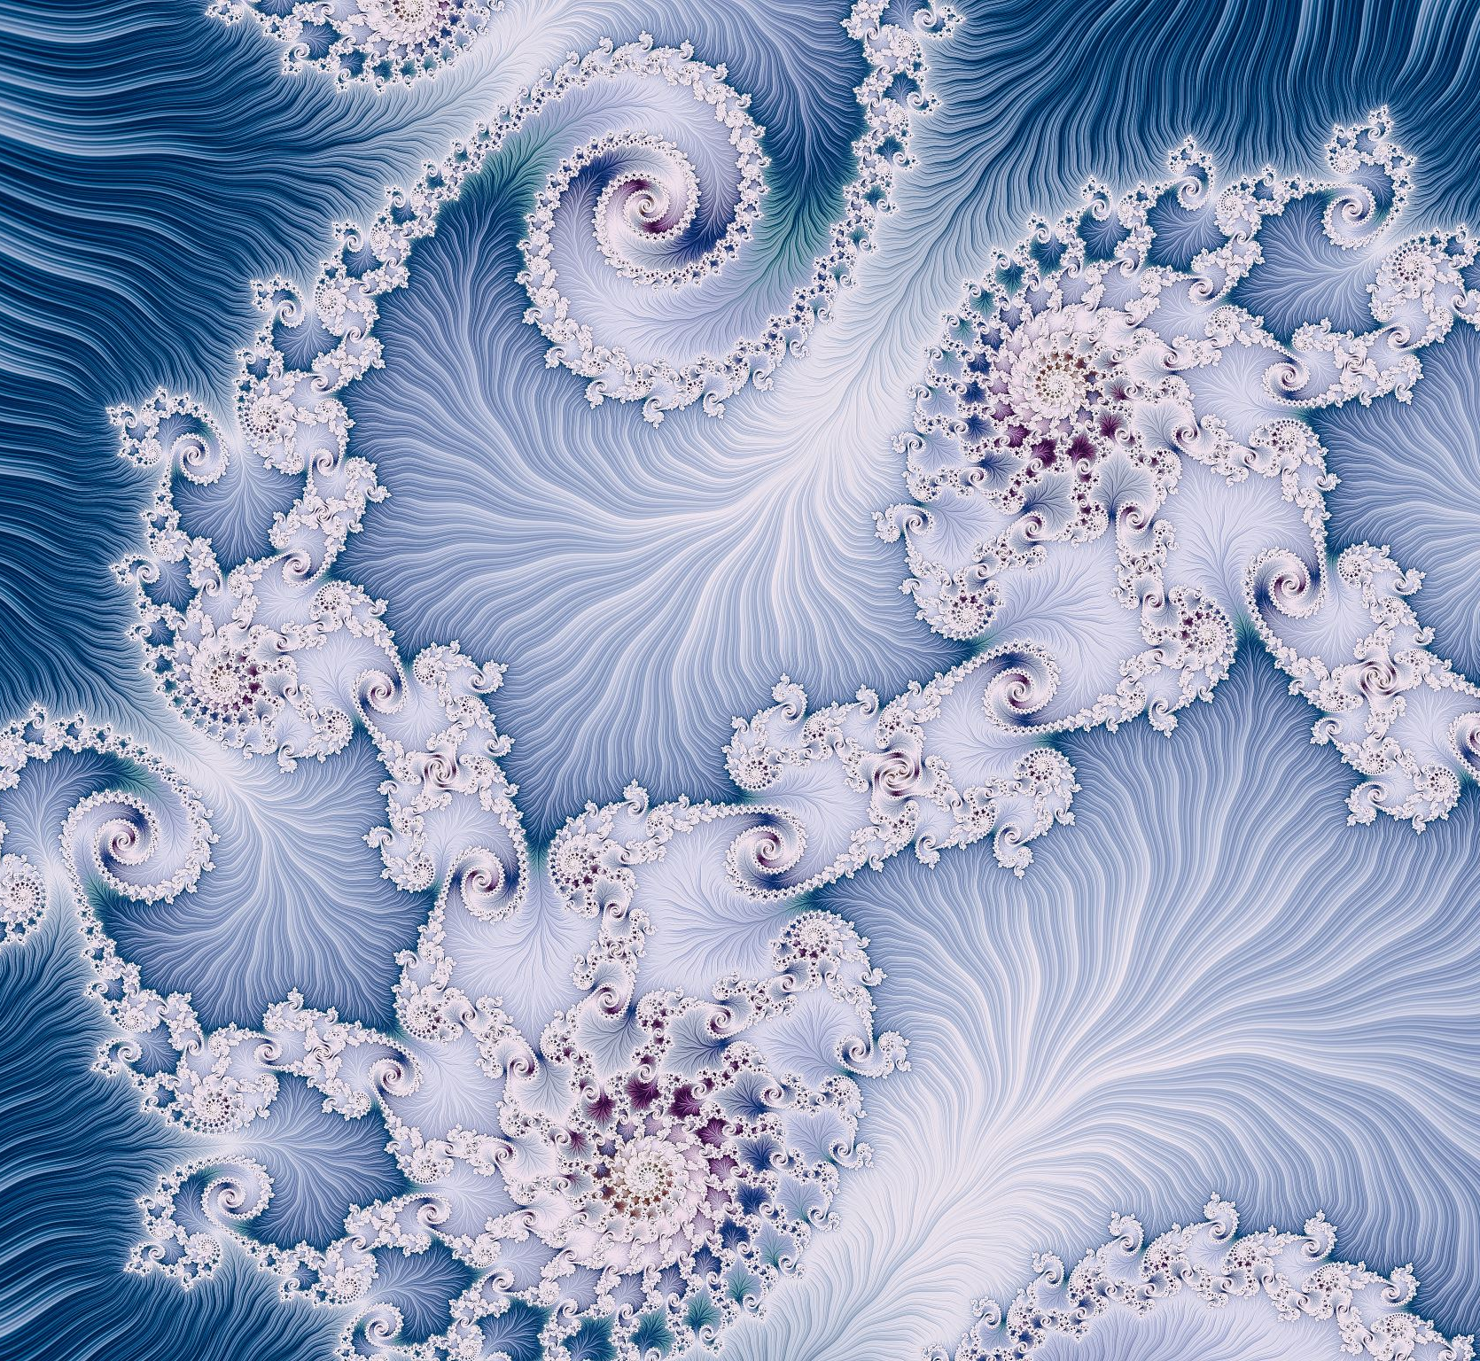
Computer Graphics
Week 3: 2D Graphics (2)

Slide 2
Sub Topics
Hierarchical Modeling using Transforms
HTML Canvas Graphics

Slide 3
Hierarchical Modeling using Transforms
Building Complex Objects
Scene Graphs
The Transform Stack

Slide 4
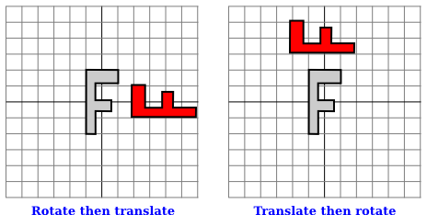
Recall: Modeling Transformations
Recall that modeling transformations
  are specified in the opposite order from the order in which they are applied to the object
  are specified before drawing the object
    translate(4,0)
    rotate(90)
    draw()
    rotate(90)
    translate(4,0)
    draw()

Slide 5
Recall: Modeling Transformations
Applying modeling transformations only on a specified object
  save the current transformation before starting work on the object
  restore it afterwards
How this is done differs from one graphics API to another, but let's suppose here that there are subroutines saveTransform() and restoreTransform() for performing those tasks
  saveTransform will make a copy of the modeling transformation that is currently in effect and store that copy
  Later, when restoreTransform is called, it will retrieve that copy and will replace the current modeling transform with the retrieved transform

Slide 6
Building Complex Objects
Typical code for drawing an object will have the form:
    saveTransform()
    translate(dx,dy) // move object into position
    rotate(r) // set the orientation of the object
    scale(sx,sy) // set the size of the object
    .
    . // draw the object, using its natural coordinates
    .
    restoreTransform()
The modeling transform moves the object from its natural coordinates into its proper place in the scene

Slide 7
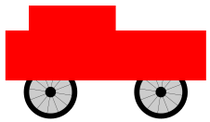
Building Complex Objects
We can build objects that are made up of smaller objects which in turn are made up of even smaller objects, to any level
Suppose that we want to draw a simple 2D image of a cart with two wheels
Here is pseudocode for a subroutine that draws the cart in its own coordinate system:
  subroutine drawCart() :
  saveTransform() // save the current transform
  translate(-1.65,-0.1) // center of first wheel will be at (-1.65,-0.1)
  scale(0.8,0.8) // scale to reduce radius from 1 to 0.8
  drawWheel() // draw the first wheel
  restoreTransform() // restore the saved transform
  saveTransform() // save it again
  translate(1.5,-0.1) // center of second wheel will be at (1.5,-0.1)
  scale(0.8,0.8) // scale to reduce radius from 1 to 0.8
  drawWheel(g2) // draw the second wheel
  restoreTransform() // restore the transform
  setDrawingColor(RED) // use red color to draw the rectangles
  fillRectangle(-3, 0, 6, 2) // draw the body of the cart
  fillRectangle(-2.3, 1, 2.6, 1) // draw the top of the cart

Slide 8
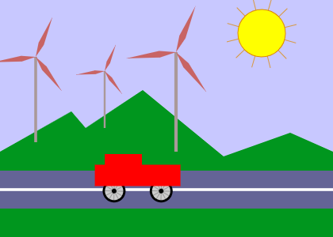
Building Complex Objects
Sample animation demo

Slide 9
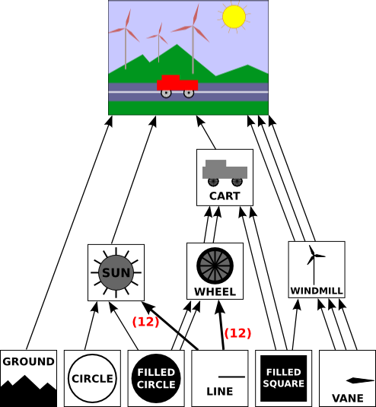
Scene Graphs
Scene graph is a data structure that represents the objects in a scene, together with attributes of the objects and the modeling transformations that are applied to the objects
A scene graph might exist only conceptually, or it might be an actual data structure in a program

Slide 10
Scene Graphs
When implementing a scene graph as a data structure made up of objects, a decision has to be made about how to handle transforms
  One option is to allow transformations to be associated with any node in the scene graph
Another decision has to be made about how to handle color
  One option is that a color on a compound object acts as a default color for its sub-objects, but color can be overridden on the sub-objects

Slide 11
The Transform Stack
When drawing a complex object, one subroutine can call other subroutines
  This means that several drawing subroutines can be active at the same time, each with its own saved transform
  When a transform is saved after another transform has already been saved, the system needs to remember both transforms
  When restoreTransform() is called, it is the most recently saved transform that should be restored → need a stack
Some graphics APIs come with transform stacks already defined
  The original OpenGL API includes the functions glPushMatrix() and glPopMatrix() for using a stack of transformation matrices
  The HTML canvas API for 2D graphics includes functions named save() and restore() that are actually push and pop operations on a stack

Slide 12
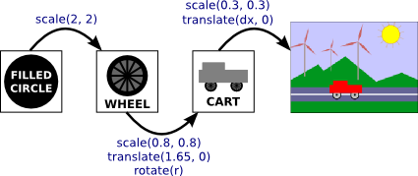
The Transform Stack
Your responsibility is to design the individual objects, in their own natural coordinate system
  specify the modeling transformations that are applied to the sub-objects of that object
You construct the scene in a similar way
The computer will then put everything together for you, considering the many layers of hierarchical structure
That's the power of hierarchical design; that's how it helps you deal with complexity

Slide 13
HTML Canvas Graphics
The 2D Graphics Context; Shapes; Stroke and Fill; Trasforms; Aux Canvas; Pixel Manipulation; Images

Slide 14
HTML Canvas Graphics
Most modern web browsers support a 2D graphics API that can be used to create images on a web page
  The API is implemented using JavaScript, the client-side programming language for the web
HTML canvas: an HTML element that can be used as a drawing surface, created with
      <canvas width="800" height="600" id="theCanvas"></canvas>
To draw on a canvas, you need a graphics context: an object that contains functions for drawing shapes and variables that record the current graphics state, including the current drawing color, transform, and font
      canvas = document.getElementById("theCanvas");
      graphics = canvas.getContext("2d");

Slide 15
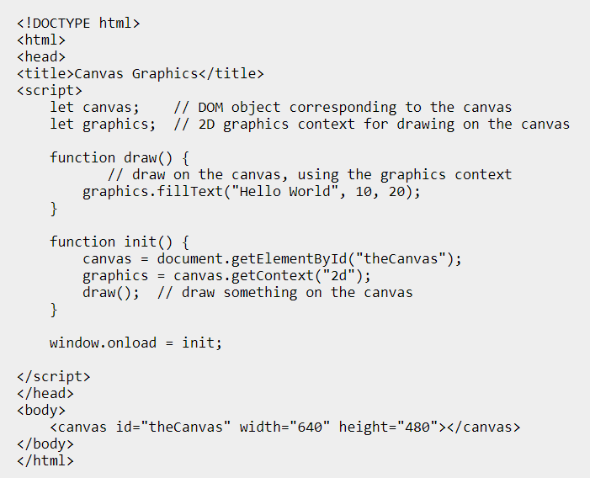

Sample HTML canvas graphics

Slide 16
Shapes
The canvas coordinate system
  Upper left corner: (0,0)
  The x-coordinate increases to the right
  The y-coordinate increases downward
HTML canvas only supports rectangles and text as the basic shapes
Other shapes must be created as paths

Slide 17
Shapes
If graphics refers to the object that represents the graphics context:
  graphics.fillRect(x,y,w,h) — draws a filled rectangle with corner at (x,y), with width w and with height h
  graphics.strokeRect(x,y,w,h) — strokes the outline of the same rectangle.
  graphics.clearRect(x,y,w,h) — clears the rectangle by filling it with fully transparent pixels, allowing the background of the canvas to show
  graphics.fillText(str,x,y) — fills the characters in the string str; the left end of the baseline of the string is positioned at the point (x,y)
  graphics.strokeText(str,x,y) — strokes the outlines of the characters in the string

Slide 18
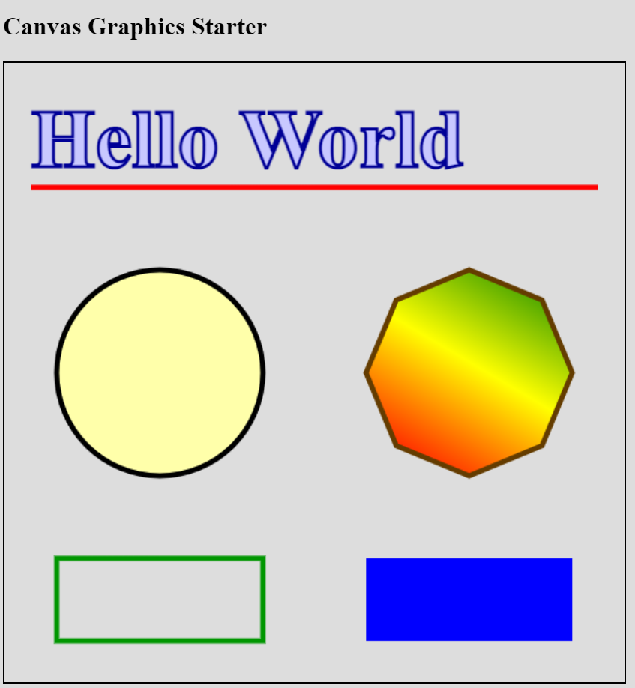

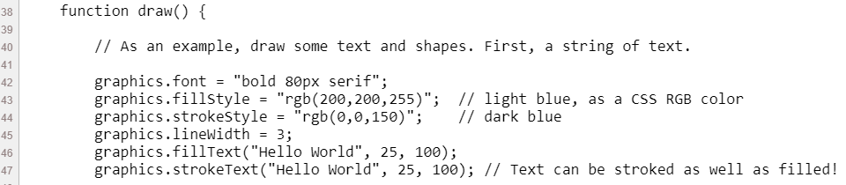
Sample Canvas
2D Graphics

Slide 19

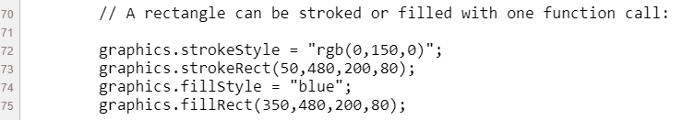
Sample Canvas
2D Graphics

Slide 20
Shapes
A path can be created using functions in the graphics context
In the current version of the API, paths are not represented by objects, and there is no way to work with more than one path at a time or to keep a copy of a path for later reuse
Paths can contain lines, Bezier curves, and circular arcs

Slide 21
Shapes
The following are functions related to paths:
  graphics.beginPath() — start a new path
  graphics.moveTo(x,y) — move the current point to (x,y), without adding anything to the path
  graphics.lineTo(x,y) — add the line segment starting at current point and ending at (x,y) to the path, and move the current point to (x,y)
  graphics.bezierCurveTo(cx1,cy1,c2x,cy2,x,y) — add a cubic Bezier curve to the path; the curve starts at the current point and ends at (x,y). The points (cx1,cy1) and (cx2,cy2) are the two control points for the curve
  graphics.quadraticCurveTo(cx,cy,x,y) — adds a quadratic Bezier curve from the current point to (x,y), with control point (cx,cy)
  graphics.arc(x,y,r,startAngle,endAngle) — adds an arc of the circle with center (x,y) and radius r. The next two parameters give the starting and ending angle of the arc. They are measured in radians. The arc extends in the positive direction from the start angle to the end angle
  graphics.closePath() — adds to the path a line from the current point back to the starting point of the current segment of the curve
Creating a curve with these commands does not draw anything
To get something visible to appear in the image, you must fill or stroke the path

Slide 22
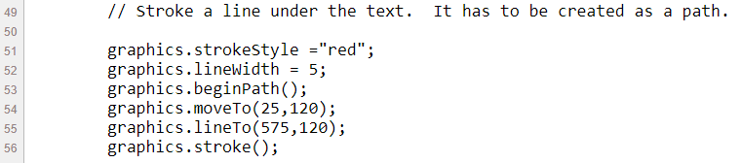
Shapes

Slide 23
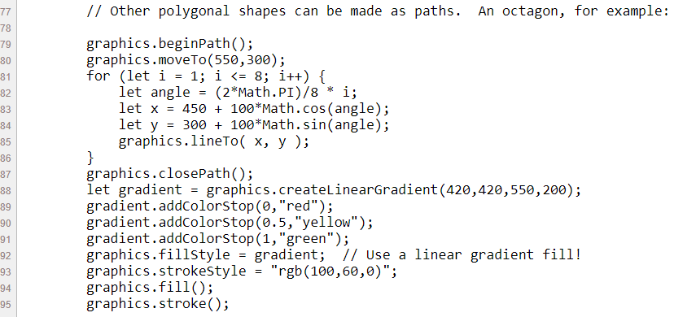


Slide 24
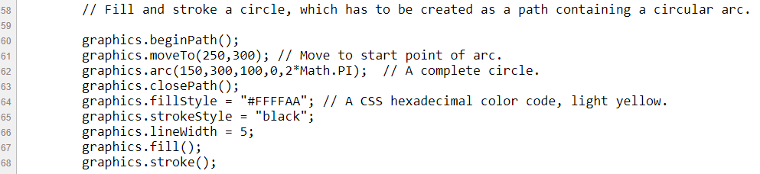
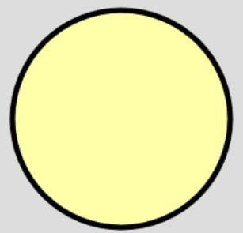
Shapes

Slide 25
Transforms
graphics.scale(sx,sy) — scale by sx in the x-direction and sy in the y-direction.
graphics.rotate(angle) — rotate by angle radians about the origin. A positive rotation is clockwise in the default coordinate system.
graphics.translate(tx,ty) — translate by tx in the x-direction and ty in the y-direction.
graphics.transform(a,b,c,d,e,f) — apply the affine transform x1 = a*x + c*y + e, and y1 = b*x + d*y + f.
graphics.setTransform(a,b,c,d,e,f) — discard the current transformation, and set the current transformation to be x1 = a*x + c*y + e, and y1 = b*x + d*y + f.

Slide 26
Transforms
graphics.save() — push a copy of the current state of the graphics context, including the current transformation, onto the stack.
graphics.restore() — remove the top item from the stack, containing a saved state of the graphics context, and restore the graphics context to that state.
Using these methods, the basic setup for drawing an object with a modeling transform becomes:
    graphics.save(); // save a copy of the current state
    graphics.translate(a,b); // apply modeling transformations
    graphics.rotate(r);
    graphics.scale(sx,sy);
    .
    . // Draw the object!
    .
    graphics.restore(); // restore the saved state

Slide 27
Discussions

Slide 28
Launch Assignment 2

